Slide 1

G2F Case Study Report
Zixiang Wen
Department of Plant, Soil and Microbial Sciences

Slide 2
Data types and possible strategies
Phenotypic data:
Inbreed phenotypic data
2014_inbred_phenotypic_data.csv, 2015_inbred_phenotypic_data.csv
Hybrid phenotypic data
g2f_2017_hybrid_data_clean.csv , g2f_2016_hybrid_data_clean.csv
g2f_2015_hybrid_data_clean.csv , g2f_2014_hybrid_data_clean.csv
Genotypic data:
Inbred genotypic data:
g2f_2017_ZeaGBSv27_Imputed_AGPv4.h5

Slide 3
Three strategies
Strategy 1
Strategy 2
Strategy 3
Inbred phenotype
Inbred genotype
Hybrid phenotype
Inbred genotype
Hybrid phenotype
Inbred genotype
GCA for inbred
Hybrid
genotype
Performance of inbred:
y= 1_{n}μ + ∑Wq_{i} + e
Performance of inbred GCA:
y= 1_{n}μ + ∑Wq_{i} + e
Performance of hybrid:
y= 1_{n}μ + ∑Wq_{i} + e
Not meaningful
Meaningful
Meaningful
√

Slide 4
Part 1:
Data cleaning

Slide 5
Datasets have been processed
Phenotypic data:
g2f_2017_hybrid_data_clean.csv
g2f_2016_hybrid_data_clean.csv
g2f_2015_hybrid_data_clean.csv
g2f_2014_hybrid_data_clean.csv
Genotypic data:
g2f_2017_ZeaGBSv27_Imputed_AGPv4.h5

Slide 6
Phenotypic data cleaning
Step 1: Extract “Plant height”, “Silk DAP” and “Grain Yield” data
Step 2: Calculate GCA for female parents grouped by location and replicate
Step 3: Combine all GCA data collected across 4 years
Step 4: Use >1.5 IQR as standard to find out outliers
Step 5: Calculate BLUP of GCA for each female parental line (n=1129)

Slide 7
Genotypic data cleaning
Step 1: Convert h5 file to hapmap format (Tassel pipeline)
Step 2: Clean and unify genotype ID
Step 3: SNP pruning (MAF >0.05, heterozygous < 0.1, missing <0.35, LD<0.70 )
Step 4: Impute and transform SNP data to numerical data (0,1,2)
SNP raw data
945,574
Clean data
136,344

Slide 8
Part 2:
Genomic selection

Slide 9
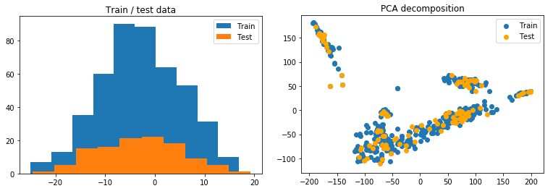
Procedures for genomic prediction
Step 1: Combine phenotypic and genotypic data
Step 2: Split data into training and test datasets (5-fold)
Step 3: Check the distribution and coverage of the two dataset
The distribution and coverage of the two dataset for yield

Slide 10
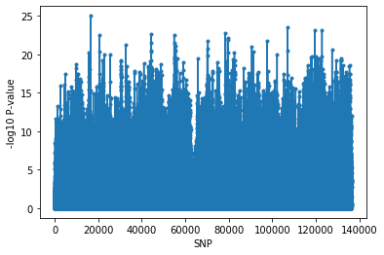
Step 4: “Best features” selection
Standard: 10k top SNP with lowest P-values in GWAS
Reasons: 1) Reduce overfitting caused by Multicollinearity
2) Save time
The distribution and coverage of the two dataset for yield

Slide 11
Step 5: Model training and fit
Training data: Green; Validation data: yellow ; Test data: Red
1. Take best parameters (Grid Search)
2. Train on training and validation data together (model.fit)
3. Test performance on test data (model.predict)

Slide 12
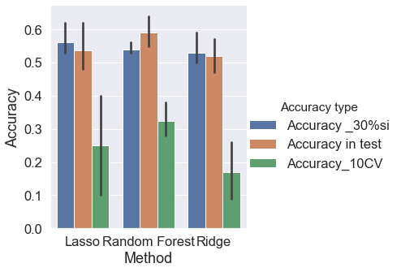
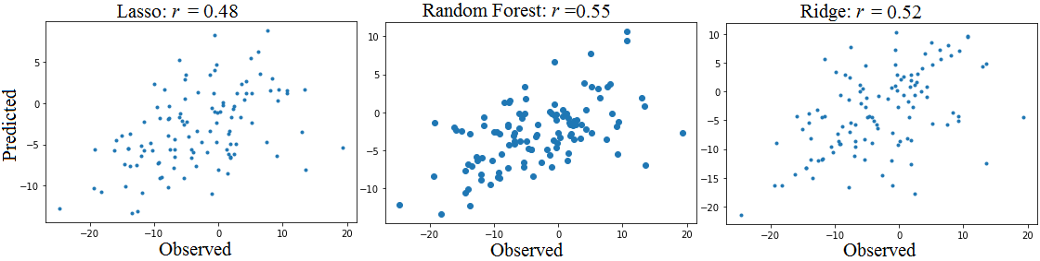
Genomic prediction results for yield
Training size: 451
Test size: 113
Model: Lasso, Random forest, Ridge
Accuracy: 0.55 ~ 0.64

Slide 13
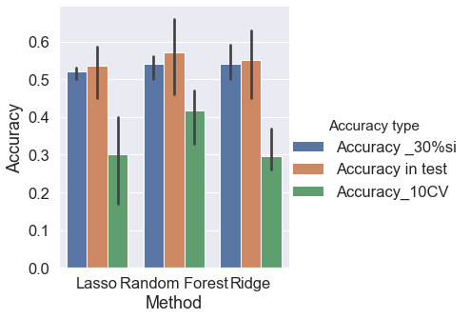
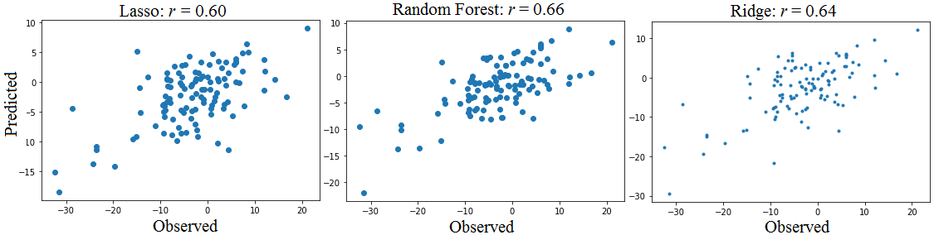
Genomic prediction results for plant height
Training size: 460
Test size: 115
Model: Lasso, Random forest, Ridge
Accuracy: 0.46~0.66

Slide 14
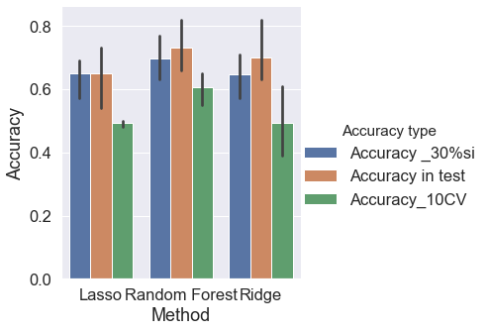
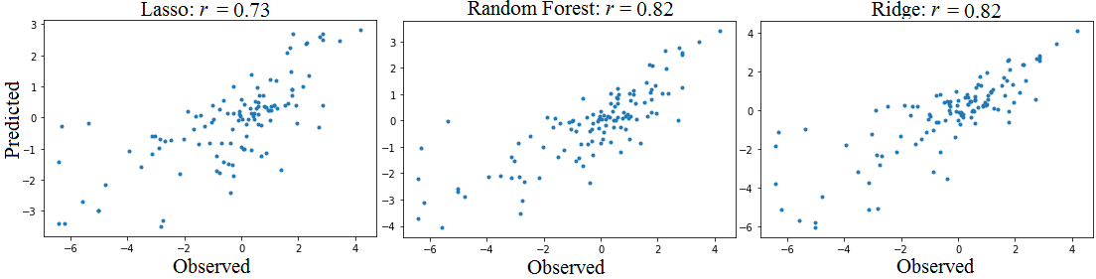
Genomic prediction results for silk DAP
Training size: 460
Test size: 115
Model: Lasso, Random forest, Ridge
Accuracy: 0.66 ~ 0.82

Slide 15
Works needed to be done in the future
1. Hyperparameter tuning for Random Forest.
2. Try Bayes method.
3. Enlarge population size for both genotyping and phenotyping
4. Separate Heterotic group for training model.
5. Predict hybrid performance directly by generating hybrid genotypes in silico based on genotypic data of parental lines.
6. Considering both the additive and dominant effect, as well as integrating environmental factors.

Slide 16
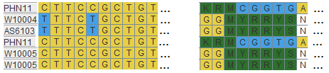
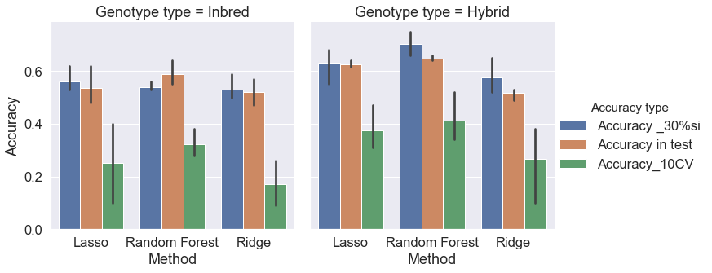
Predict hybrid performance directly by generating hybrid genotypes in silico
Strategy 3
Generating hybrid genotypes in silico
Hybrid phenotype
Inbred genotype
Hybrid
genotype
Performance of hybrid:
y= 1_{n}μ + ∑Wq_{i} + e
Prediction accuracy increased by 10%
Accuracy at top 30% selection intensity reach 0.75

Slide 17
Thanks for your attention!

Slide 18
Most analyses were implemented in python
Data cleaning:
Pandas
numpy
R (lme4)
Genomic selection:
Sklearn.model_selection ,
linear_model, sklearn.metrics,
GridSearchCV, Lassso, Ridge, RandomForestRegressor

